Slide 2
Section One
Section Five
WHO WE ARE
RESEARCH
Section Two
Section Six
OUR STRATEGY
INNOVATION
Section Three
Section Seven
STUDENT-CENTERED ACADEMICS
A GLOBAL NETWORK
Section Eight
Section Four
COMMUNITY AND CULTURE
OUR FACULTY
Neil Armstrong statue
Located on Stadium Avenue by the Neil Armstrong Hall of Engineering

Slide 3
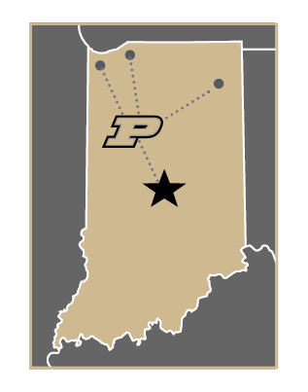
WHO WE ARE
Over 150 Years of Pursuing Innovation
What is a Boilermaker?
In the 1890s, an area newspaper referred to our winning football team as “Burly Boiler Makers from Purdue.” The nickname stuck, and so did our reputation for hard work, industriousness and commitment.
Where is Purdue?
Nestled in the heart of the Midwest, Purdue offers an ideal college experience for any student — from our traditional campus in West Lafayette, Indiana, to a vibrant urban campus in Indianapolis, or in one of our online offerings, Purdue University Online and Purdue Global.
Throughout our history, generations of Boilermakers have left their mark in small steps and giant leaps.
And today we continue in those footsteps. We keep going with every tiny epiphany that comes from the thrill of discovery and with each unexpected realization that uncovers new knowledge and possibility. We keep going because it’s what keeps us going — persistent in our pursuit of innovation, again and again and again.

Slide 4
WHO WE ARE
We trace our origin to a defining moment in our country’s history: July 2, 1862. During the darkest days of the Civil War, President Abraham Lincoln signed a bill to preserve the industrial spirit of a divided nation.
From our Cradle of Astronauts including Neil Armstrong, to beloved athletes like Drew Brees, to Nobel Prize winners like
Ei-ichi Negishi, our legacy reaches far, wide and deep. Together we continue to take the small steps that move us all forward.
This bill, the Morrill Act, granted over 1 million acres of federal land to endow at least one university in every state — a uniquely American idea. These land-grant universities were not meant to be exclusive to the wealthy or elite.
With this belief at the core of its founding, Purdue has since opened its doors to the instigators of progress, discovery and innovation, delivering excellence at scale. Today, our service goes beyond red-brick exteriors — with an urban campus, online instruction and a new solution for working adults.

Slide 5
WHO WE ARE

Slide 6
OUR STRATEGY
Building a Better World, Together
Purdue University in Indianapolis
Purdue Computes
Mitchell E. Daniels, Jr. School of Business
Purdue Computes is a major new initiative emphasizing four key pillars of Purdue’s extensive technological and computational environment: the advancement of physical artificial intelligence, the elevation of our already-successful computer science and computer engineering programs, quantum science and engineering, and semiconductor research and development.
An extension of our flagship campus, Purdue University in Indianapolis expands Purdue’s academic and research excellence to Indiana’s capital city, while investing in and partnering with Indianapolis businesses to significantly grow the tech-driven economy throughout the state.
The Mitchell E. Daniels, Jr. School of Business offers a STEM-infused, future-focused business education for the leaders and founders of tomorrow. Celebrating a president who led transformative change during his tenure, the reimagined business school prepares graduates who generate value in the world and lead with vision and versatility.

Slide 7
OUR STRATEGY
Purdue’s Next Moves
National Security and Technology
Purdue Applied Research Institute (PARI)
Through a strategic focus on the systems that keep us safe and secure, we’re exploring new energetic materials and systems, hypersonic and space vehicles, cybersecurity, and secure microelectronics.
In addition to key presidential initiatives, the university is focused on an ambitious agenda called Purdue Moves. In 2021, Purdue’s Next Moves were announced to continue our momentum.
Through PARI, we will focus on digital innovation in agri-food systems, national security and technology, and global development and innovation.
Transformative Education 2.0
Plant Sciences 2.0
Purdue Equity Task Force
By investing in plant sciences, we will grow graduates, entrepreneurs and the agricultural biotech industry to ensure a future in which the environment and agriculture work hand in hand to both feed the world’s population and strengthen our ecosystems.
We will offer the most innovative residential learning program in the U.S. among large research universities through a deep investment in high-touch experiential learning opportunities, creative use of advanced technologies, flexible degree options, integrated student-life experiences and a data-driven ecosystem.
We are committed to ensuring every member of the university community can experience all Purdue has to offer equitably, focusing on barriers to success of students, faculty and staff of color and specifically the experience of Black Boilermakers.

Slide 8
STUDENT-CENTERED ACADEMICS
At Purdue, we’re transforming learning inside and outside the classroom. New teaching methods, collaborative environments and innovative experiences on and off campus prepare Boilermakers for successful careers and fulfilling lives.
An education that doesn’t stop
Our immersive education helps students incorporate internships, study abroad and research into their experience, while programs
like Summer Start and Degree in 3 increase graduation rates and allow students to complete their degrees faster.
Tuition that’s affordable
We believe that all students should be able to afford and access a world-class Purdue education. So we’ve frozen tuition every single year since 2012-13, locking in this rate through at least 2025-26.

Slide 9
STUDENT-CENTERED ACADEMICS

Slide 10
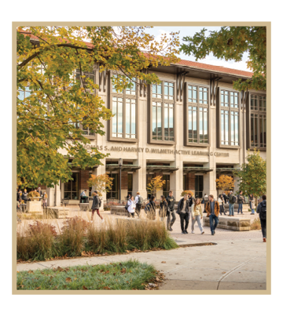
STUDENT-CENTERED ACADEMICS
World-class graduate degrees
We offer 160-plus graduate programs on our West Lafayette campus, including top-ranked master’s, doctoral and professional degrees — with both residential and online options. As a worldwide leader in discovery and innovation, we tackle complex global issues every day. New investments in research are routine at Purdue, like the historic $100 million development of Purdue’s campus from Lilly Endowment Inc. announced in January 2024 — the largest gift in the university’s history. Every new research award brings new opportunities to our programs of study and students.
A better-prepared workforce
We’re giving our students every advantage as they seek the jobs of the future. At our Industrial Roundtable career fair, nearly 15,000 students interact and make connections with representatives from approximately 400 companies that span a variety of cutting-edge fields and industries.
Thomas S. and Harvey D. Wilmeth Active Learning Center
The 164,000-square-foot Thomas S. and Harvey D. Wilmeth Active Learning Center includes collaborative active-learning rooms, an engineering and science library, and 24/7 study spaces.
What can Boilermakers accomplish next?

Slide 11
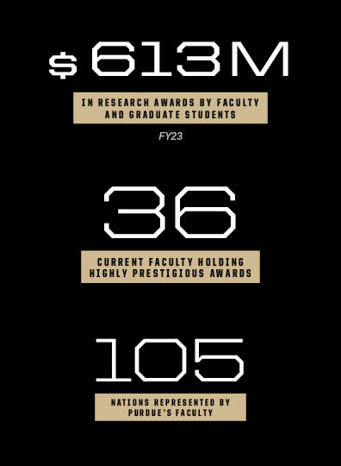
OUR FACULTY
Beyond their exceptional teaching prowess, our faculty members stand out as relentless researchers, delving into groundbreaking studies that shape the future of their respective fields. Their commitment to advancing knowledge in real-world applications is underscored by a number of prestigious awards, including:
1 A.M. Turing Award laureate
7 National Medal of Science laureates
3 World Food Prize laureates
6 Pulitzer Prize winners
7 National Medal of Technology and Innovation laureates
7 Nobel laureates
Student-centered teaching
Our faculty are redesigning courses to include more discussion, activity and interaction, and more opportunities for practical application, internships and real-world problem-solving, creating students who are better prepared for life after graduation.
Shaping Minds, Inspiring Futures

Slide 12
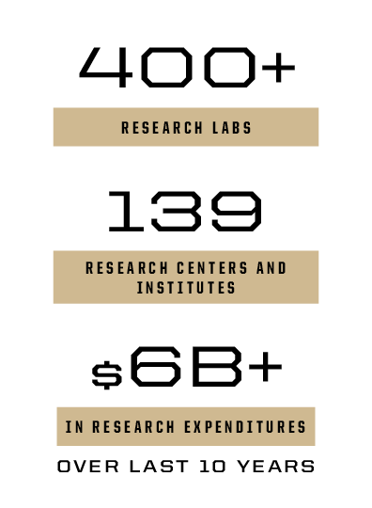
RESEARCH
Today, we’re building on our strength in STEM to answer the call for more innovation, economic growth and solutions to global challenges. We are champions for research and innovation on a global scale. Purdue researchers and innovators have advanced thinking in:
Physical artificial intelligence
Semiconductors and microelectronics
Drug discovery and cancer research
Cybersecurity
Global sustainability
Computing
Quantum science and engineering
Purdue wins Regional Technology and Innovation Hubs
Purdue is the leading university partner for three federal Regional Technology and Innovation Hubs — the Silicon Crossroads Microelectronics Commons, the Midwest Alliance for Clean Hydrogen and Heartland BioWorks — which are assigned to regions poised to ensure the U.S. is globally competitive in areas that are key to national security. Purdue is the nation’s only higher ed institution selected as a leading university in all three national hubs awarded in 2023.
The recent U.S. Economic Development Administration Tech Hubs Program was initiated as part of the CHIPS and Science Act of 2022, with $10 billion authorized over five years and $500 million in FY23 appropriated to launch the program. Out of close to 200 applications across the country, only 31 were designated by the EDA as Regional Technology and Innovation Hubs.
The Relentless Drive That Propels Us Forward
World-changing research
As a member of the Association of American Universities, an organization composed of America’s leading research universities, Purdue is among the nation’s top public and most innovative research institutions. Purdue leverages deep strengths in multiple research fields, including the highly ranked College of Veterinary Medicine, to advance cancer prevention, detection, diagnosis and treatment, through the Purdue Institute for Cancer Research.

Slide 13
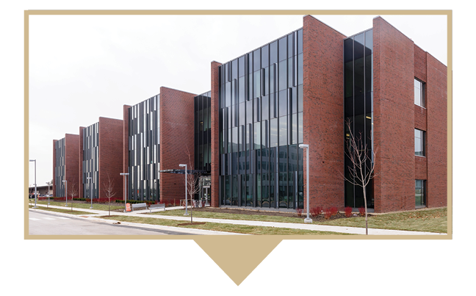
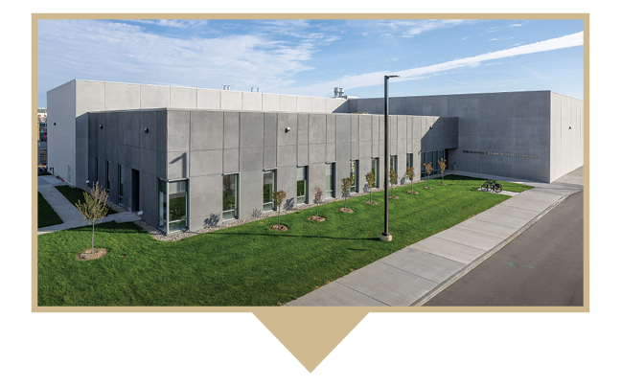
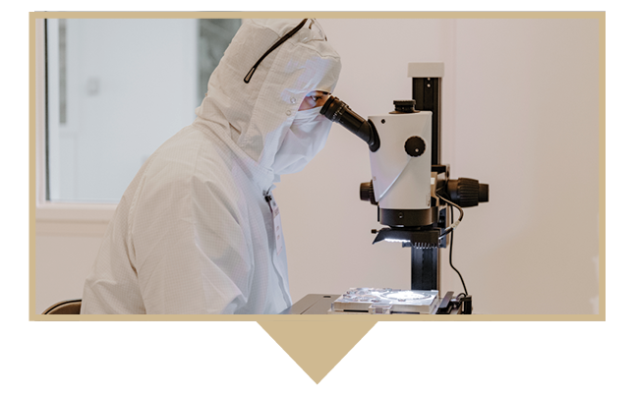
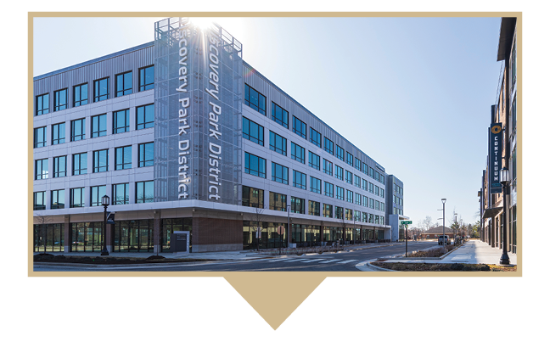
RESEARCH
Large-Scale, Impactful Research
Flex Lab
Hypersonics and Applied Research Facility
A 108,000-square-foot wet-lab/dry-lab and collaborative space supporting boundary-breaking innovation across disciplines.
A $41 million, 65,000-square-foot building with two cutting-edge wind tunnels — including the world’s only Mach 8 quiet wind tunnel.
Birck Nanotechnology Center
Discovery Park District at Purdue
Ag Alumni Seed Phenotyping Facility
A 186,000-square-foot microelectronics research facility and home to the Scifres Nanofabrication Laboratory, one of the nation’s largest cleanrooms.
A $1 billion mixed-use development of housing, high-end manufacturing, and industry- and research-driven partnerships. Includes test facilities, created in collaboration with Rolls-Royce, that span 80 acres, powering the next generation of U.S. military aircraft.
A 7,300-square-foot plant phenotyping facility that has automated conveyers, precision irrigation, and nutrient and atmospheric controls with imaging capabilities that include RGB, hyperspectral and X-ray scanning of roots for plants up to 13 feet tall.

Slide 14
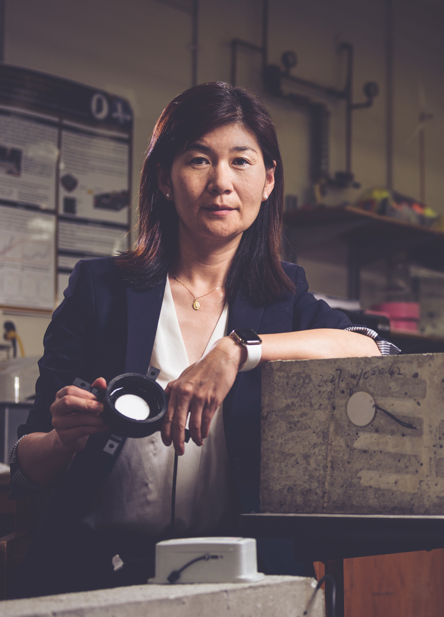
INNOVATION
Linda Lee — developed remediation technologies for forever chemicals, including per- and polyfluoroalkyl substances (PFAS), compounds recognized for their potentially harmful human health or ecological health effects.
Gebisa Ejeta — developed sorghum strains that can withstand droughts and parasites, improving food security for hundreds of millions of people in sub-Saharan Africa.
Jacqueline Linnes and Sulma Mohammed — created a low-cost, point-of-care paper test that could revolutionize cervical cancer detection worldwide
It’s one thing to make new discoveries daily, but it’s quite another to use them to address some of the world’s most important issues we face today. From global warming to early cancer detection to malaria treatment, we believe in building a better world together.
With the establishment of a new strategic initiative, Purdue Innovates, we’ve committed to becoming a jumping-off point for faculty, staff, students, alumni, industry partners and investors to come together to bring their ideas and innovations to the marketplace and to the world.
Purdue innovations can be found in all 50 U.S. states and in about 100 countries around the world. Millions of people benefit from Purdue’s cutting-edge research and the inventions our faculty and students go on to create. For example:
Martin (John) Atalla — co-invented the silicon MOSFET (metal-oxide-semiconductor field-effect transistor), one of the most widely used types of integrated circuits in microchips.
Luna Lu (pictured here) — developed “smart concrete,” a technology that decreases roadway construction time and how often concrete pavement needs repairs, and improves the road’s sustainability.

Slide 15
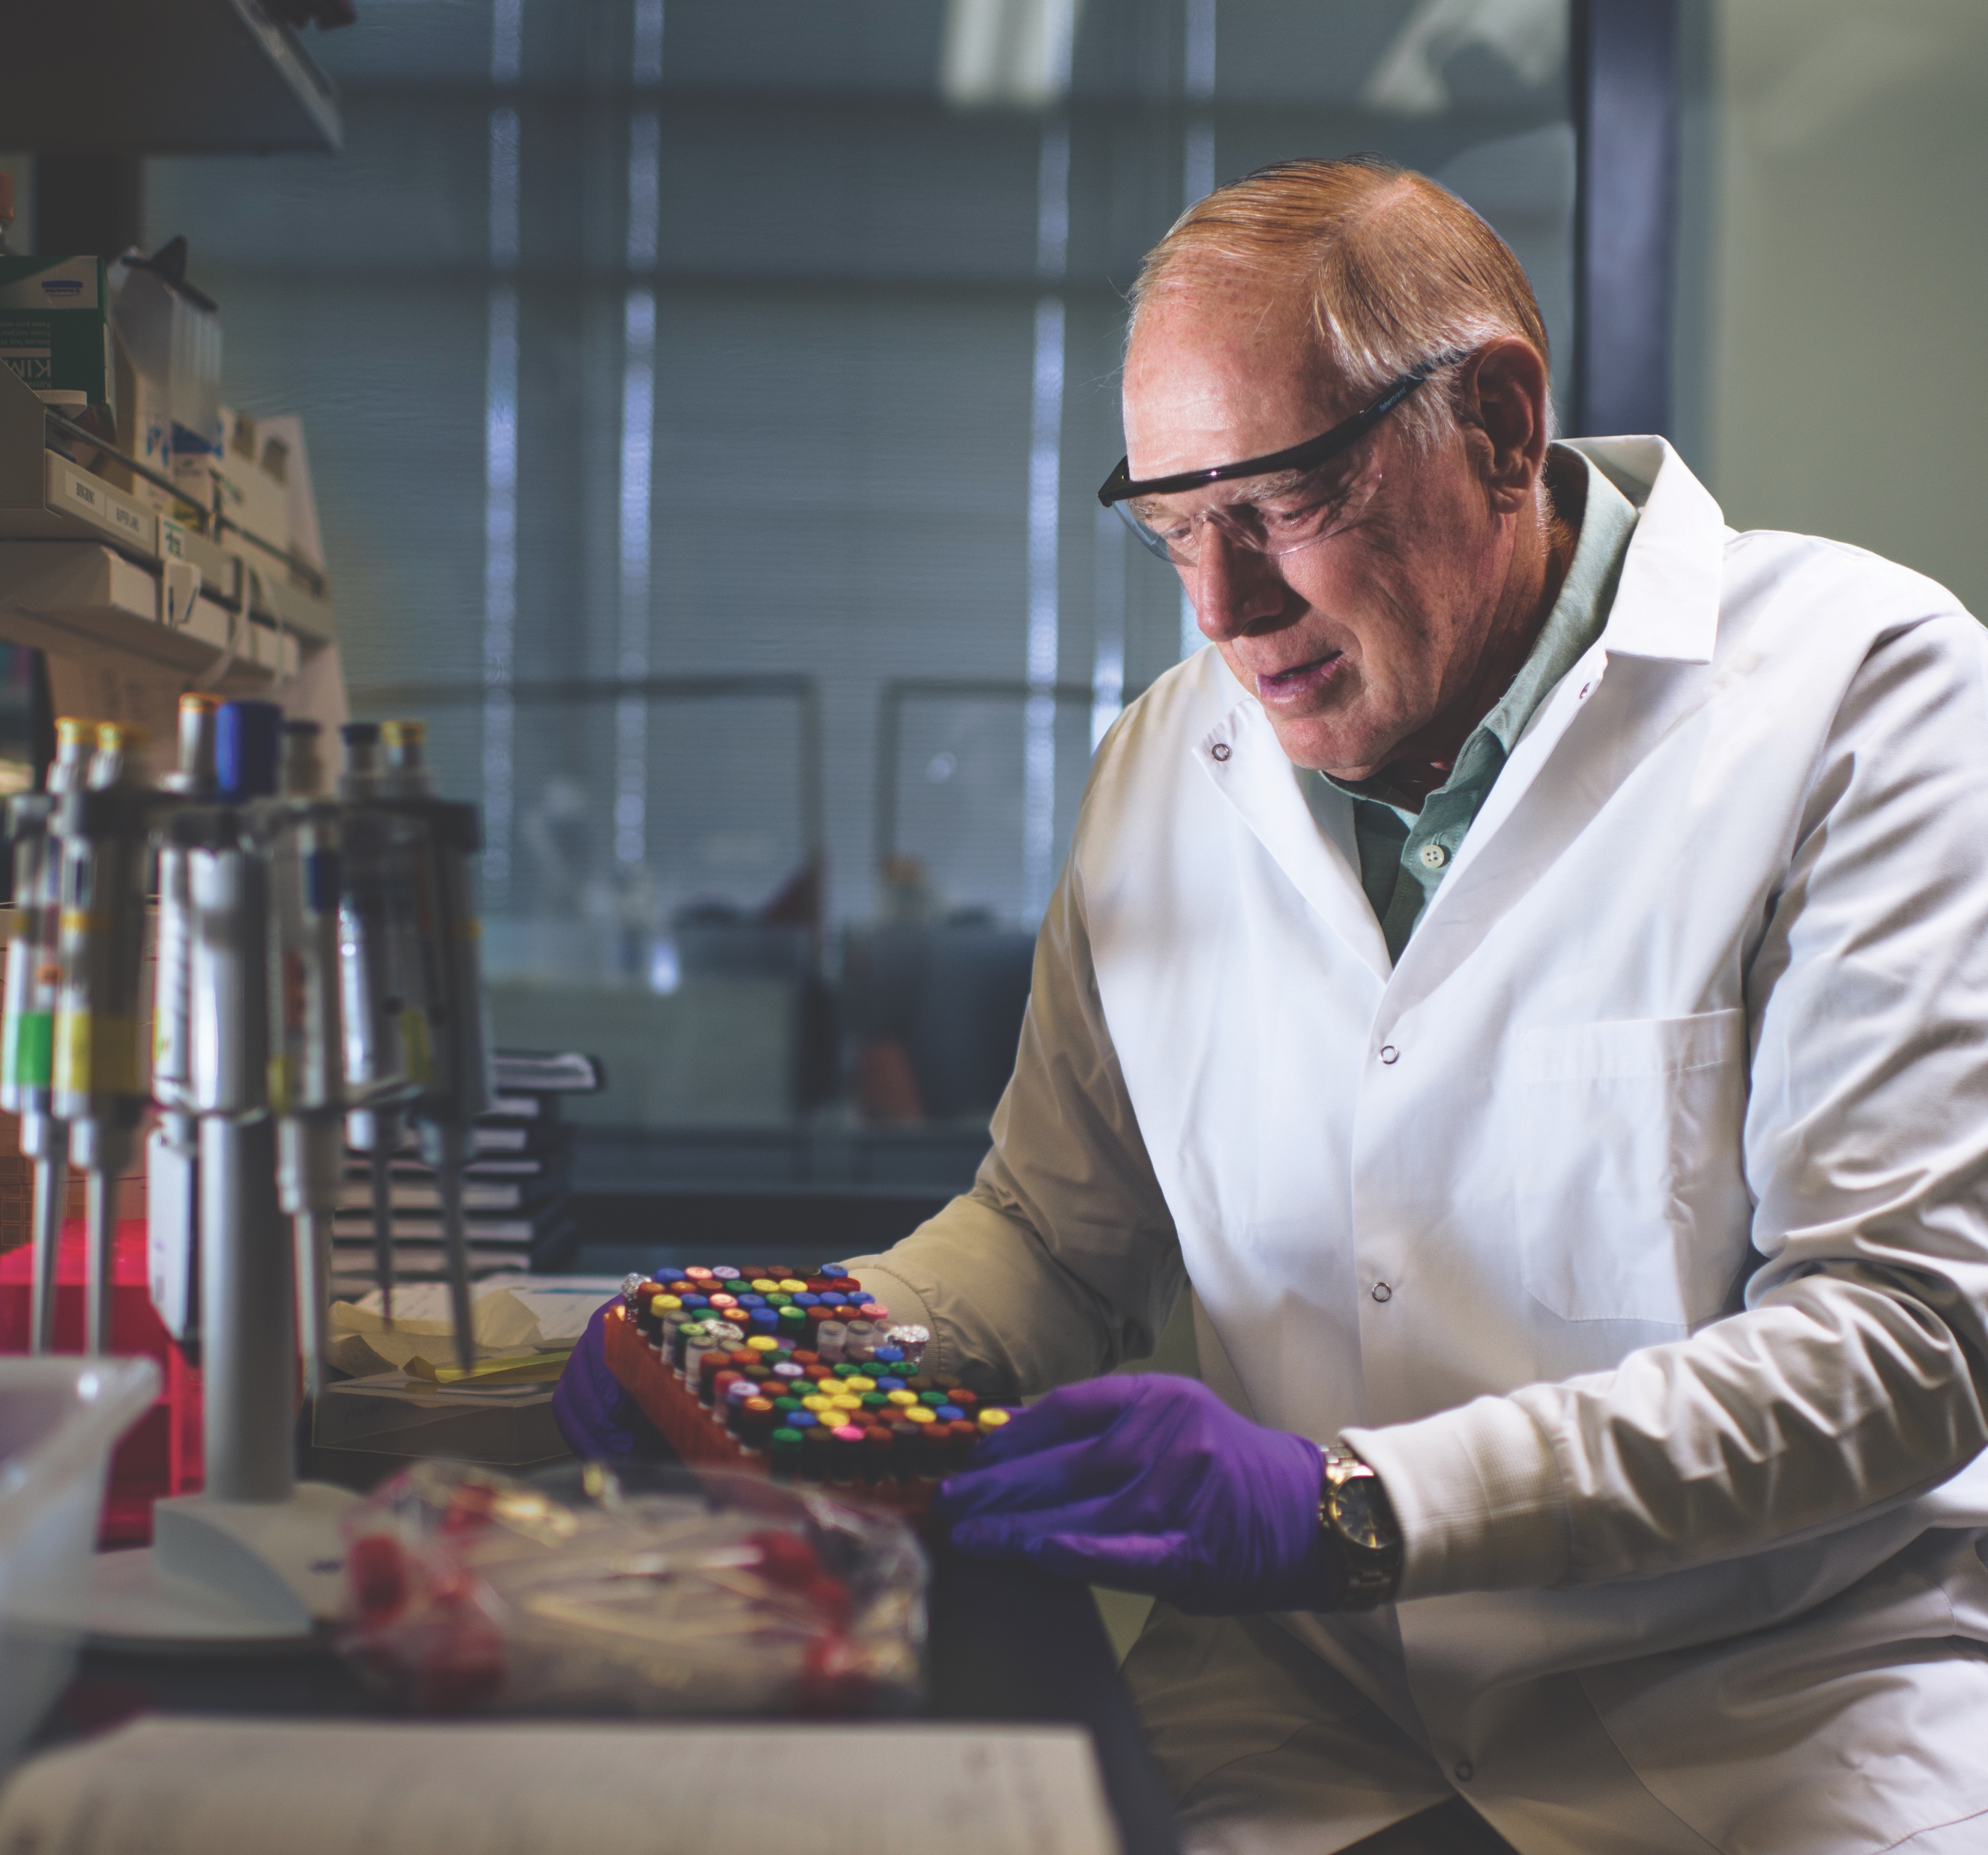
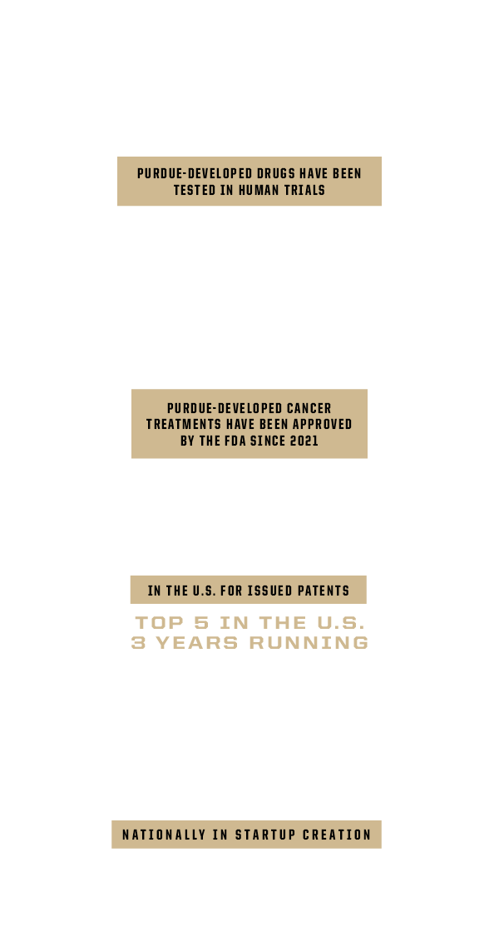
INNOVATION
Where World-Changing Ideas Come to Life
Our top-tier researchers at Purdue benefit from a myriad of resources that bridge the gap between their groundbreaking efforts in the lab and the many intricacies of business law, patents and product promotion that are required to bring a world-changing idea to market. This creates an ecosystem where startups thrive.
A few notable startups from Purdue include:
Umoja Biopharma — a Purdue University-affiliated biotechnology company focused on using a patient’s own immune cells to kill cancerous cells.
Neurava — a medical device startup backed by Purdue that is developing a first-of-its-kind wearable device capable of identifying and alerting for seizures.
OmniVis — a Purdue University-affiliated biotechnology company focused on the speed, accuracy and economics of pathogen detection.

Slide 16
A GLOBAL NETWORK
Over 108,000 Strong
Fall 2023 Enrollment

Slide 17
A GLOBAL NETWORK
A
Airport
America’s Hard-Tech Corridor
C
Commercial air service returns to Purdue University Airport in 2024.
After almost 20 years, commercial air service is returning to the Purdue University Airport with nonstop flights connecting Greater Lafayette and Chicago. Commercial flights from Purdue will expand Discovery Park District at Purdue; serve the Greater Lafayette community; further accelerate economic growth; and synergize with the teaching, research and innovation of the future of modern air mobility that amplify the heritage of flying at Purdue University.
Purdue invests in making the Hard-Tech Corridor the most consequential engine of economic growth in the Midwest.
Purdue University in Indianapolis will serve as one bookend for a 65-mile-long Hard-Tech Corridor in Indiana, stretching from downtown Indianapolis, through the LEAP Innovation District in Lebanon with new sites from companies such as Eli Lilly and Co., all the way to Discovery Park District in West Lafayette.
Serving Beyond Our Red-Brick Exteriors
B
Broadband
D
Purdue@DC
Purdue launches broadband team in an effort to increase high-speed internet access, adoption and use throughout Indiana.
Through its presence in every county in Indiana, Purdue is taking a leading role to ensure all Indiana families and businesses have access to affordable broadband internet service — which is crucial for success in the 21st century. Purdue is ensuring data accuracy that will help the state of Indiana in deploying the $868 million in federal funding from the Broadband Equity, Access, and Deployment Program for high-speed internet improvements.
Purdue University serves our nation by bringing unique strengths to the capital.
The Purdue@DC initiative is a commitment to expand Purdue’s footprint in our nation’s capital in an impactful way through five areas of concentration: the Krach Institute for Tech Diplomacy, the Purdue Applied Research Institute’s focus on national security and defense, PARI’s focus on global development and innovation, the Boilers Go to D.C. program, and the continued development of key government partnerships.
Purdue is making strides in the development and support of our home state through four key “ABCD” focuses.

Slide 18
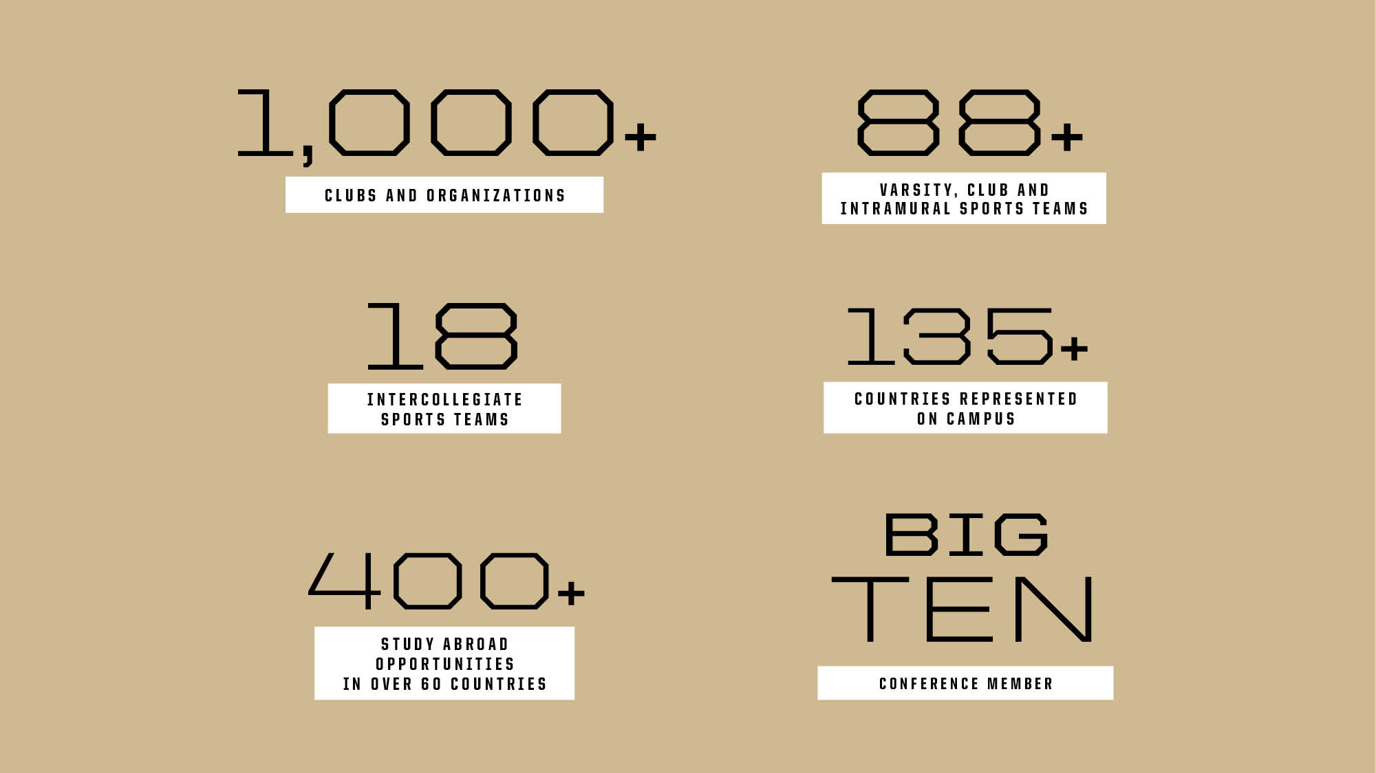
A GLOBAL NETWORK

Slide 19
COMMUNITY & CULTURE
We are proud of the community that grows here. Purdue brings together students from every background, every perspective and every walk of life to uncover new knowledge, understand who we are as individuals and create meaningful change that will transform the world.
The complete university experience
In our university residences, students learn and grow through the relationships they make, becoming a close-knit community of civic-minded global citizens. With unique educational opportunities, cultural centers, recreation and clubs, access to faculty members, and proximity to a wealth of campus resources, every Purdue student has room to focus on their goals, while getting the full collegiate experience, all in one place. On our West Lafayette campus, students can walk from their residence hall to class to Mackey Arena in the same day — our Division I athletics bring a kinetic atmosphere to campus on game day that’s impossible to re-create.
Living and learning together
Students also have the opportunity to incorporate collaborative learning into their Purdue experience through learning communities. For example, our John Martinson Honors College and Residences enables 850 honors students to live and learn together within 20,000 square feet of academic space.
Engagement beyond the classroom
Students not only have the chance to gain new experiences on our campuses but are also able to take part in critical industries across the country. In 2023 alone, Purdue hosted leaders from government, industry and academia at the CHIPS for America summit in Washington, D.C.; the annual Tech Freedom Summit presented by the Krach Institute for Tech Diplomacy; the eXcellence in Manufacturing and Operations Initiative summit; the Purdue Silicon Summit; and more. And in 2023, Purdue motorsports engineering students were on 32 of the 33 IndyCar teams participating in the Indy 500.

Slide 20
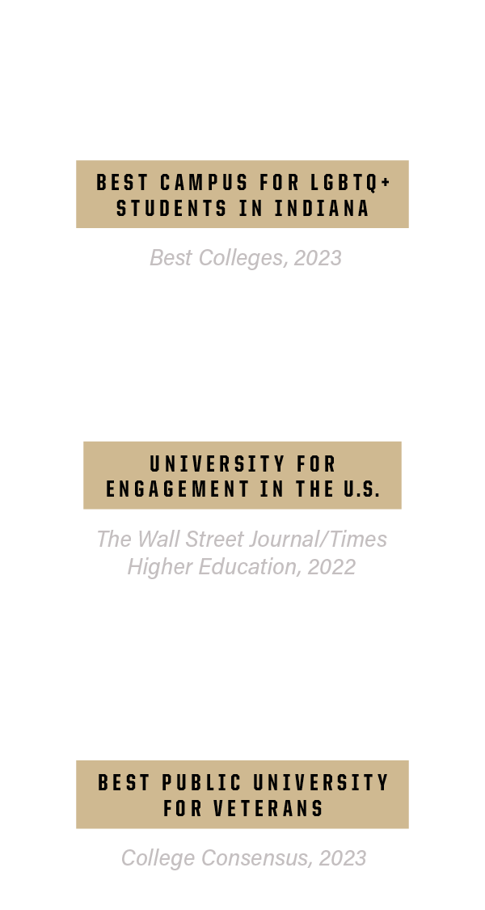
COMMUNITY & CULTURE

Slide 21
For more information about Purdue University, visit
purdue.edu
For Purdue’s best stories, visit
stories.purdue.edu
@PurdueUniversity
@LifeAtPurdue
@PurdueGlobal
To view the information included in this presentation as a PDF or a printable document, visit the Purdue MarCom website.

