Slide 1


Slide 2

Section One
Section Five
WHO WE ARE
RESEARCH
Section Two
Section Six
OUR STRATEGY
INNOVATION
Section Three
Section Seven
STUDENT-CENTERED ACADEMICS
A GLOBAL NETWORK
Section Eight
Section Four
COMMUNITY & CULTURE
OUR FACULTY
Neil Armstrong statue
Located on Stadium Avenue by the Neil Armstrong Hall of Engineering

Slide 3
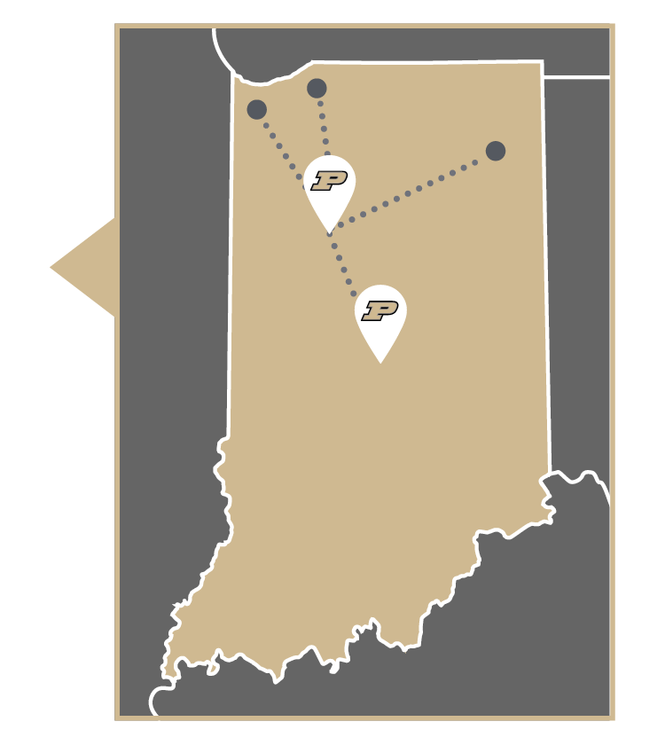

WHO WE ARE
Over 155 Years of Pursuing Innovation
What is a Boilermaker?
In the 1890s, an area newspaper referred to our winning football team as “Burly Boiler Makers from Purdue.” The nickname stuck, and so did our reputation for hard work, industriousness and commitment.
No matter what kind of student you are, Purdue University has a place for you.
Purdue’s systemwide options include several distinct educational opportunities for domestic and international students, transfer students, or adults looking to further their education. These options include locations throughout Indiana, as well as online opportunities that span the globe.
Throughout our history, generations of Boilermakers have left their mark in small steps and giant leaps.
And today we continue in those footsteps. We keep going with every tiny epiphany that comes from the thrill of discovery and with each unexpected realization that uncovers new knowledge and possibility. We keep going because it’s what keeps us going — persistent in our pursuit of innovation, again and again and again.

Slide 4



WHO WE ARE
We trace our origin to a defining moment in our country’s history: July 2, 1862. During the darkest days of the Civil War, President Abraham Lincoln signed a bill to preserve the industrial spirit of a divided nation.
From our Cradle of Astronauts including Neil Armstrong, to beloved athletes like Drew Brees, to Nobel Prize winners like
Ei-ichi Negishi, our legacy reaches far, wide and deep. Together we continue to take the small steps that move us all forward.
This bill, the Morrill Act, granted over 1 million acres of federal land to endow at least one university in every state — a uniquely American idea. These land-grant universities were not meant to be exclusive to the wealthy or elite.
With this belief at the core of its founding, Purdue has since opened its doors to the instigators of progress, discovery and innovation, delivering excellence at scale. Today, our service goes beyond red-brick exteriors — with an urban location, online instruction and a new solution for working adults.

Slide 5
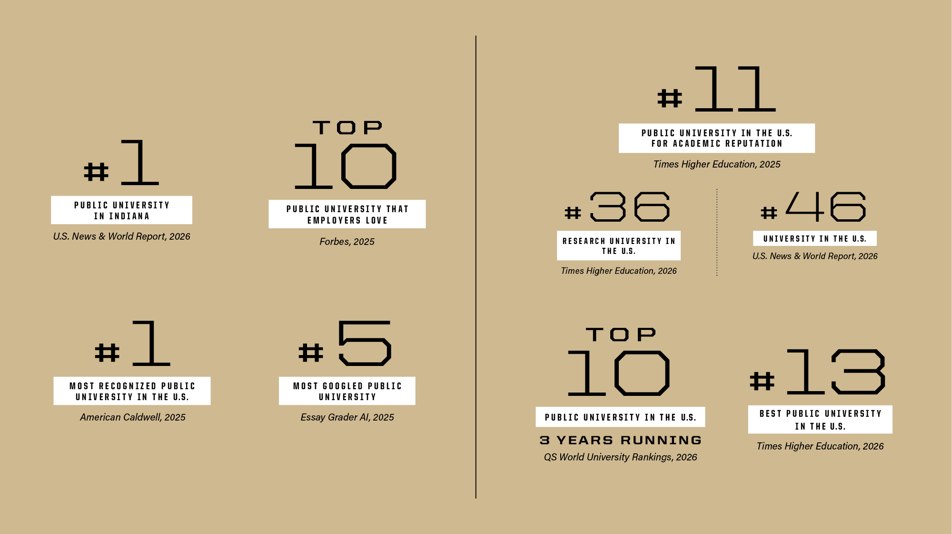
WHO WE ARE

Slide 6




OUR STRATEGY
Building a Better World, Together
Purdue University in Indianapolis
Purdue Computes
Daniels School of Business
Purdue One Health
Purdue Computes emphasizes four key pillars of Purdue’s extensive technological and computational environment: the advancement of physical artificial intelligence, the elevation of our already-successful computer science and computer engineering programs, quantum science and engineering, and semiconductor research and development.
As an urban expansion of our West Lafayette location, Purdue University in Indianapolis extends Purdue’s academic and research excellence to Indiana’s capital city while investing in and partnering with Indianapolis businesses to significantly grow the tech-driven economy throughout the state.
The Mitch Daniels School of Business offers a STEM-infused, future-focused business education for the leaders and founders of tomorrow. Celebrating a president who led transformative change during his tenure, the reimagined business school prepares graduates who generate value in the world and lead with vision and versatility.
Purdue One Health is focused on solving complex challenges at the intersection of human, animal and plant health and delivering real-world impact. Purdue is working to improve health outcomes and foster economic growth through four key pillars: academic programs, research, facility infrastructure and industry partnerships.

Slide 7
OUR STRATEGY
Lilly + Purdue: Accelerating the future of medicine
Collaboration That Transforms Tomorrow
Together, Eli Lilly and Company and Purdue will accelerate drug discovery, bridge the gap between research and clinical application, and strengthen supply chains with advanced technology. With Purdue researchers working alongside Lilly scientists in West Lafayette, Indianapolis, and the LEAP Research and Innovation District, this partnership is reshaping how medicines are discovered, developed and delivered — bringing innovation from the lab to the lives of patients faster than ever before.
SK hynix + Purdue: Building America’s Silicon Heartland
When global leaders look to accelerate innovation, they turn to Purdue. Together, we’re pioneering breakthroughs in health and technology that will define the future.
Purdue and SK hynix are creating a transformative hub for semiconductor innovation in West Lafayette. Backed by a $3.87 billion investment from SK hynix and supported by $458 million in CHIPS Act funding, this initiative will establish one of the largest AI semiconductor advanced packaging and R&D facilities ever located on a university campus.

Slide 8
OUR STRATEGY
Serving Beyond Our Red-Brick Exteriors
Broadband
Purdue@DC
Purdue continues to work with Indiana communities as broadband investments take place across the state. After the launch of the Purdue broadband team’s focus on mapping and infrastructure, several Purdue programs now provide digital skills and literacy to farmers, workers and the general public. Some of these programs include the Institute for Digital and Advanced Agricultural Systems, Purdue Extension Community Development and the Purdue Center for Regional Development.
The Purdue@DC initiative is a commitment to expand Purdue’s footprint in our nation’s capital through five areas of concentration: the Krach Institute for Tech Diplomacy, the Purdue Applied Research Institute’s focus on national security and defense, PARI’s focus on global development and innovation, the Boilers Go to D.C. program, and the continued development of key government partnerships.
In addition to Purdue’s main strategic initiatives, the university focuses on priorities that increase Purdue’s impact on every corner of the world.
Airport
Entrepreneurship
America’s Hard Tech Corridor
The Purdue University Airport is a key resource for Purdue and the Greater Lafayette community, connecting West Lafayette to the world with daily nonstop flights to Chicago’s O’Hare International Airport. Named after a beloved Boilermaker mentor, the new Amelia Earhart Terminal elevates the entire Purdue Airport experience.
Commercial flights from Purdue expand Discovery Park District at Purdue; serve the Greater Lafayette community; further accelerate economic growth; and synergize with the teaching, research and innovation of modern air mobility’s future, amplifying the heritage of flying at Purdue.
Through Purdue Innovates, the university unifies commercialization, startup incubation and venture investment to accelerate the path from idea to impact. By protecting intellectual property, funding early-stage ventures, and guiding founders through accelerators and fellowships, Purdue ensures Boilermaker innovations reach markets and improve lives worldwide. This priority builds on Purdue’s legacy as a top university for patents and startup creation, turning trials and testing into breakthroughs that fuel economic growth and shape our world.
Purdue University in Indianapolis will serve as one bookend for the 65-mile-long Hard Tech Corridor in Indiana, stretching from downtown Indianapolis through the LEAP District in Lebanon with new sites from companies such as Lilly, all the way to Discovery Park District in West Lafayette.

Slide 9
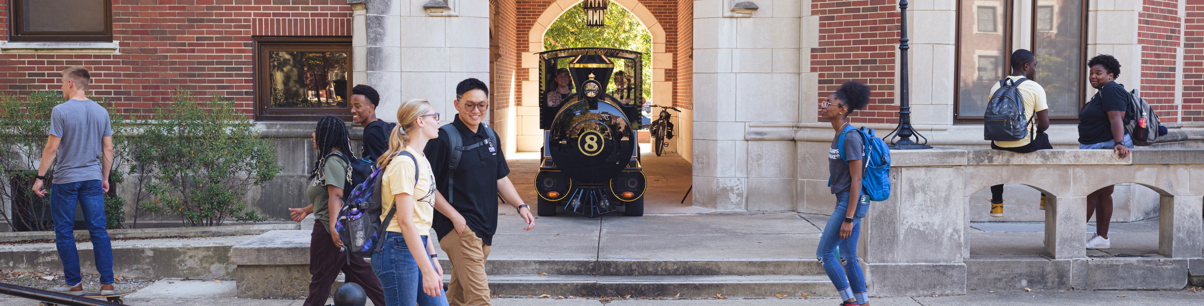

STUDENT-CENTERED ACADEMICS
At Purdue, we’re transforming learning inside and outside the classroom. New teaching methods, collaborative environments and innovative experiences on and off campus prepare Boilermakers for successful careers and fulfilling lives.
An education that doesn’t stop
Our immersive education helps students incorporate internships, study abroad and research into their experience, while programs
like Early Start and Degree in 3 increase graduation rates and allow students to complete their degrees faster.
Tuition that’s affordable
We believe that all students should be able to afford and access a world-class Purdue education. So we’ve frozen tuition every single year since 2012-13, locking in this rate through at least 2026-27.

Slide 10
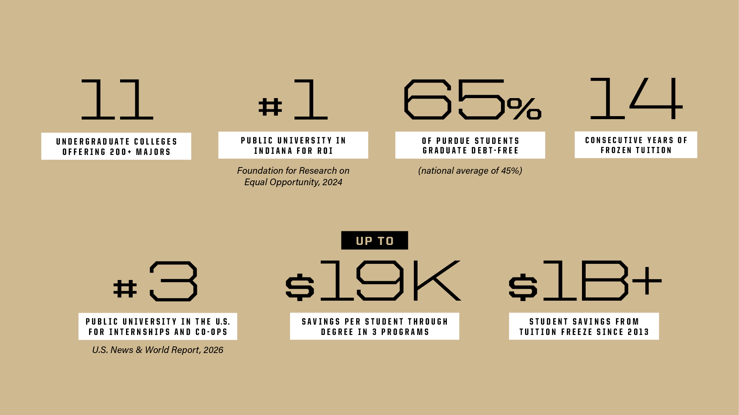
STUDENT-CENTERED ACADEMICS

Slide 11
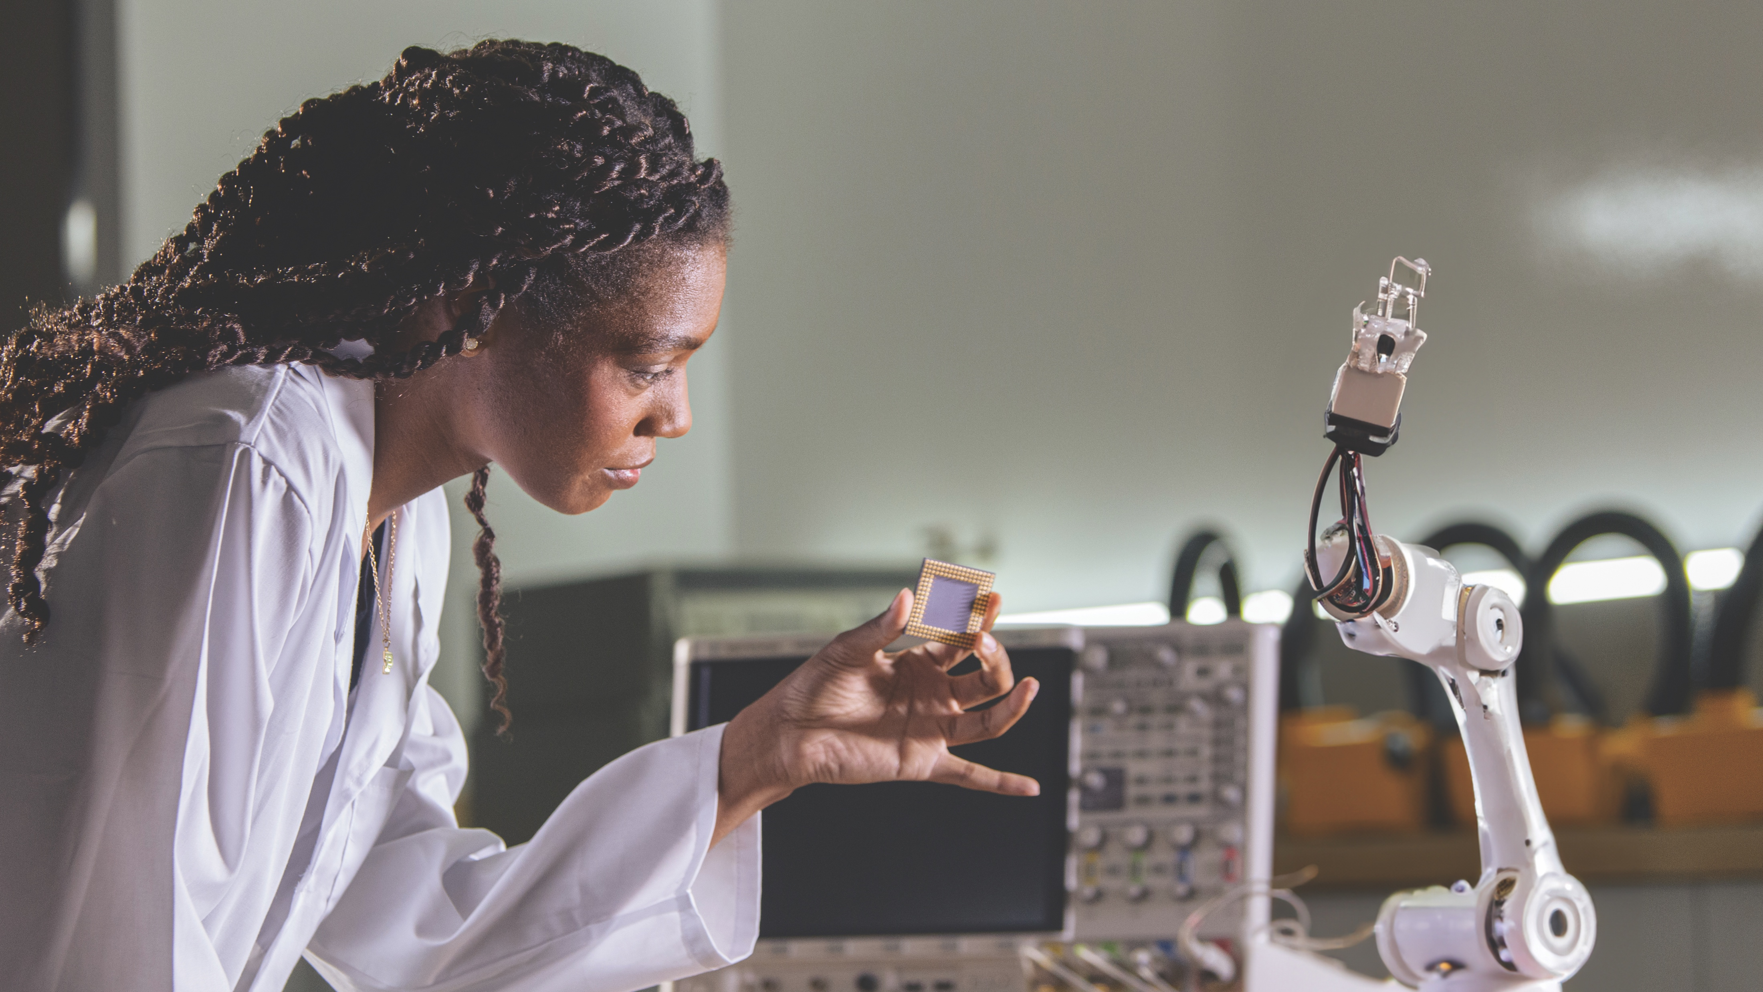
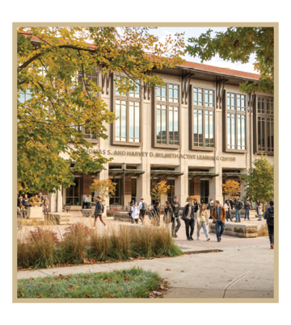

STUDENT-CENTERED ACADEMICS
World-class graduate degrees
We offer 160-plus graduate programs at our West Lafayette location, including top-ranked master’s, doctoral and professional degrees — with both residential and online options. As a worldwide leader in discovery and innovation, we tackle complex global issues every day. New investments in research are routine at Purdue, like the historic $100 million contribution from Lilly Endowment Inc. announced in January 2024 — the largest gift in the university’s history. Every new research award brings new opportunities to our programs of study and students.
A better-prepared workforce
We’re giving our students every advantage as they seek the jobs of the future. At our Industrial Roundtable career fair, nearly 15,000 students interact and make connections with representatives from approximately 400 companies that span a variety of cutting-edge fields and industries.
Thomas S. and Harvey D. Wilmeth Active Learning Center
The 164,000-square-foot Thomas S. and Harvey D. Wilmeth Active Learning Center includes collaborative active-learning rooms, an engineering and science library, and 24/7 study spaces.
What can Boilermakers accomplish next?

Slide 12

OUR FACULTY
Beyond their exceptional teaching prowess, our faculty members stand out as relentless researchers, delving into groundbreaking studies that shape the future of their respective fields. Their commitment to advancing knowledge in real-world applications is underscored by a number of prestigious awards, including:
1 A.M. Turing Award laureate
7 National Medal of Science laureates
3 World Food Prize laureates
6 Pulitzer Prize winners
7 National Medal of Technology and Innovation laureates
7 Nobel Prize laureates
Student-centered teaching
Our faculty are redesigning courses to include more discussion, activity and interaction, and more opportunities for practical application, internships and real-world problem-solving, creating students who are better prepared for life after graduation.
Shaping Minds, Inspiring Futures

Slide 13
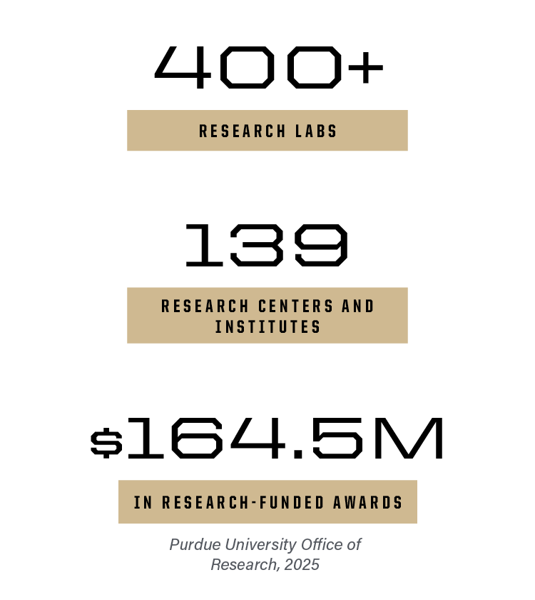
RESEARCH
The Relentless Drive That Propels Us Forward
World-changing research
As a member of the Association of American Universities, an organization composed of America’s leading research universities, Purdue is among the nation’s top public and most innovative research institutions. Purdue leverages deep strengths in multiple research fields to advance cancer prevention, detection, diagnosis and treatment through the Purdue Institute for Cancer Research.
Today, we’re building on our strength in STEM to answer the call for more innovation, economic growth and solutions to global challenges. We are champions for research and innovation on a global scale. Purdue researchers and innovators have advanced thinking in:
Physical artificial intelligence
Semiconductors and microelectronics
Drug discovery and cancer research
Cybersecurity
Global sustainability
Computing
Quantum science and engineering
Purdue wins Regional Technology and Innovation Hubs
Purdue is the only university in the nation named a leading partner in all three federal Regional Technology and Innovation Hubs awarded in 2023: the Silicon Crossroads Microelectronics Commons Hub, the Midwest Alliance for Clean Hydrogen and Heartland BioWorks. These hubs, created through the CHIPS and Science Act of 2022, strengthen U.S. competitiveness in areas vital to national security. Of nearly 200 applicants, only 31 hubs were designated by the U.S. Economic Development Administration, including Heartland BioWorks.

Slide 14
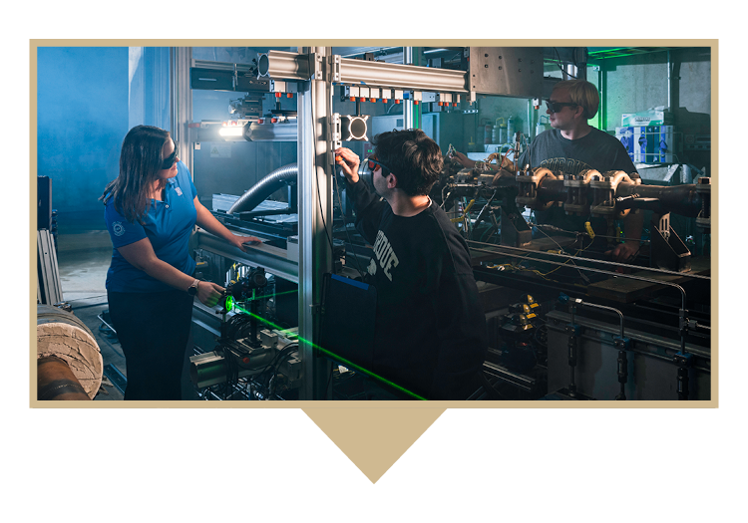
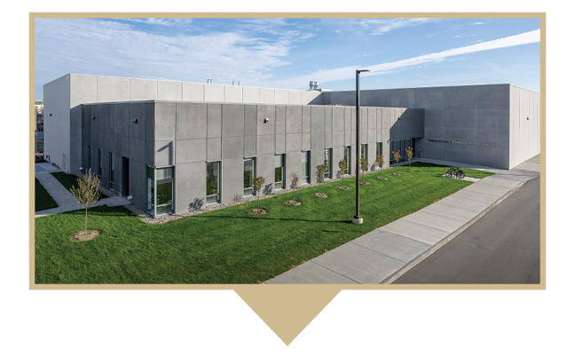
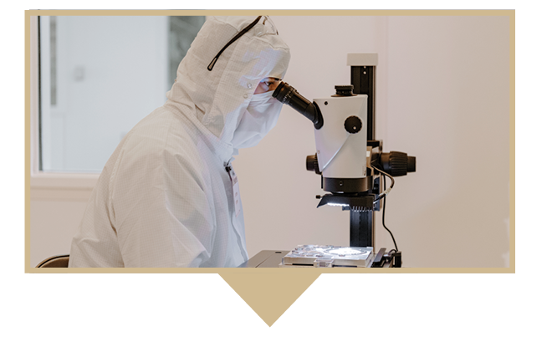
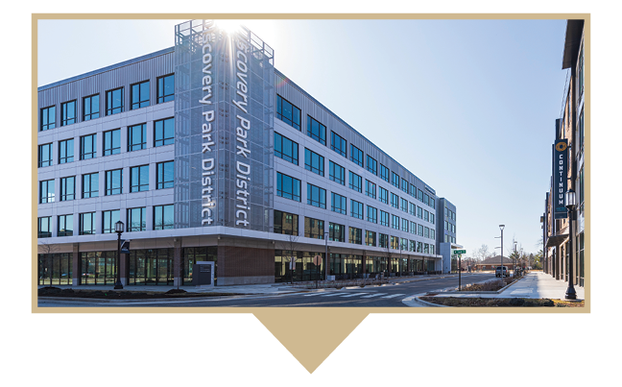

RESEARCH
Large-Scale, Impactful Research
Zucrow Labs
Hypersonics and Applied Research Facility
A 24-acre campus hosting world-class research facilities in combustion, turbines and compressors, energetic materials, hypersonics, aerodynamics, fluid mechanics, and more. Founded in 1948, Zucrow is the largest academic propulsion lab in the world.
A $41 million, 65,000-square-foot building with two cutting-edge wind tunnels — including the world’s only Mach 8 quiet wind tunnel.
A strong, critical mass of researchers and state-of-the-art facilities set Purdue apart.
Birck Nanotechnology Center
Discovery Park District at Purdue
Ag Alumni Seed Phenotyping Facility
A 186,000-square-foot microelectronics research facility and home to the Scifres Nanofabrication Laboratory, one of the nation’s largest cleanrooms.
A $1 billion mixed-use development of housing, high-end manufacturing, and industry- and research-driven partnerships. Includes test facilities, created in collaboration with Rolls-Royce, that span 80 acres, powering the next generation of U.S. military aircraft.
A 7,300-square-foot plant phenotyping facility that has automated conveyers, precision irrigation, and nutrient and atmospheric controls with imaging capabilities that include RGB, hyperspectral and X-ray scanning of roots for plants up to 13 feet tall.

Slide 15
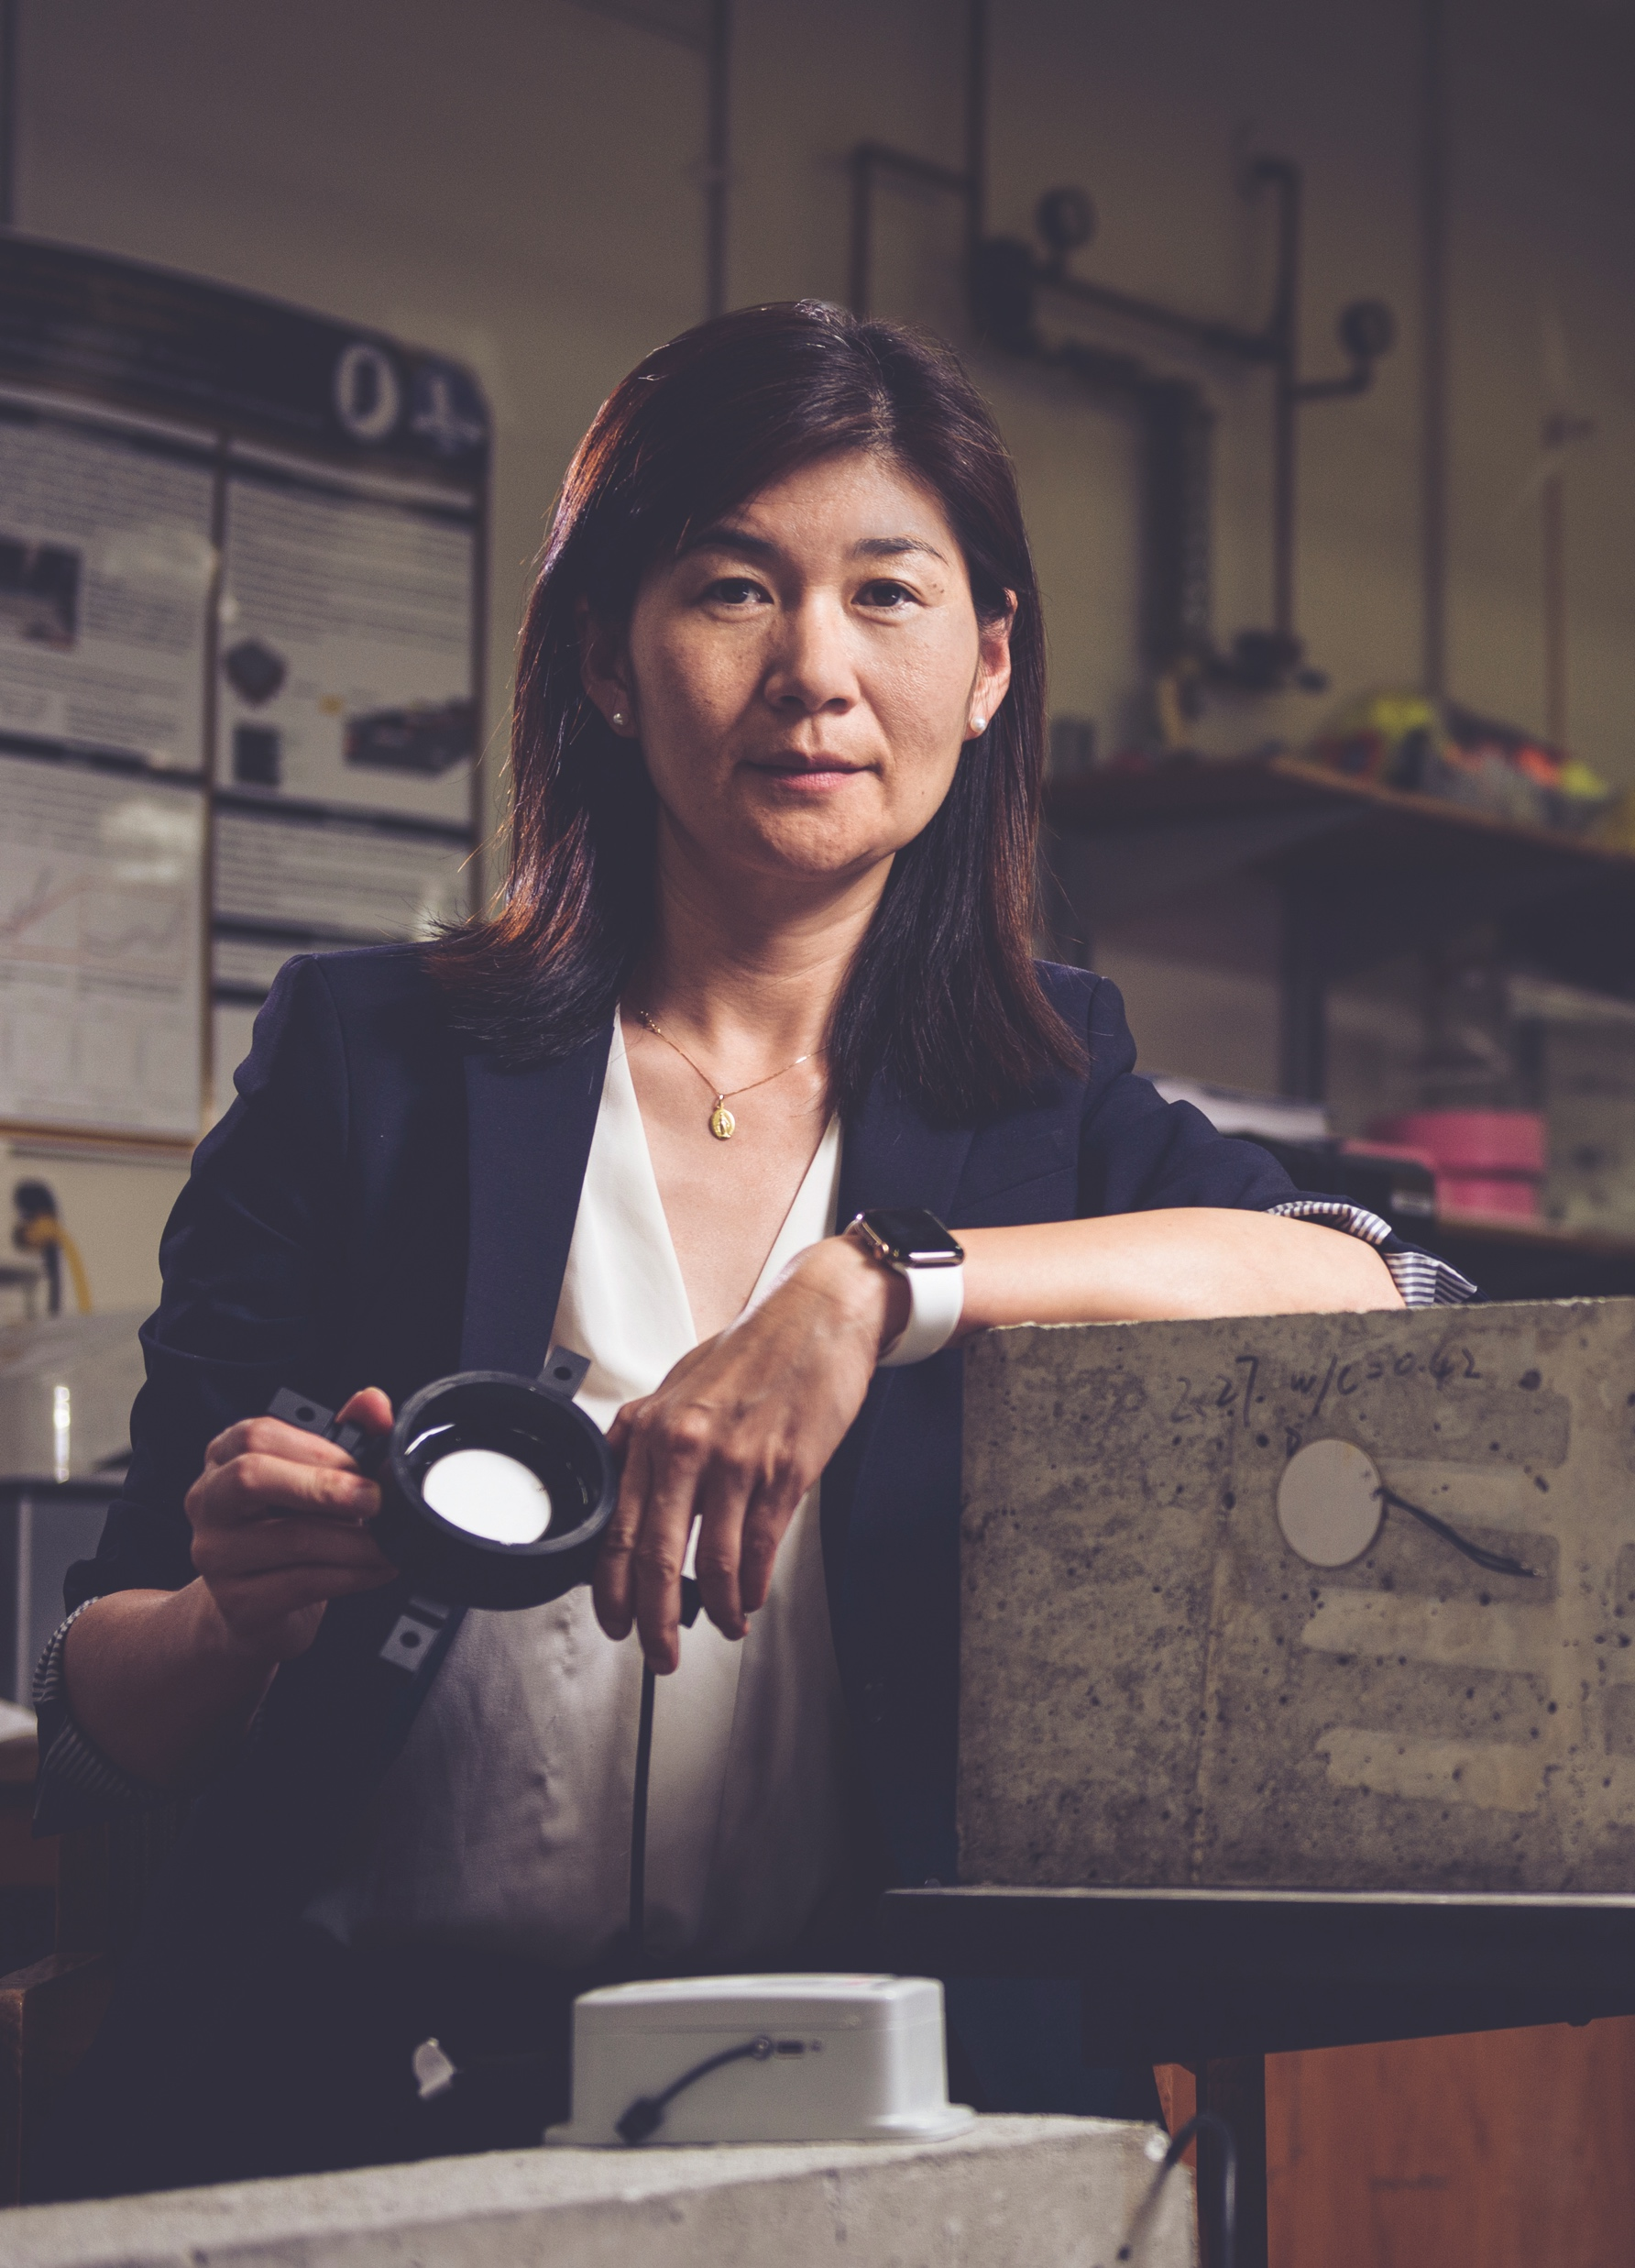

INNOVATION
Linda Lee developed remediation technologies for forever chemicals, including per- and polyfluoroalkyl substances, compounds recognized for their potentially harmful human health or ecological health effects.
Gebisa Ejeta developed sorghum strains that can withstand droughts and parasites, improving food security for hundreds of millions of people in sub-Saharan Africa.
Jacqueline Linnes and Sulma Mohammed created a low-cost, point-of-care paper test that could revolutionize cervical cancer detection worldwide.
It’s one thing to make new discoveries daily, but it’s quite another to use them to address some of the world’s most important issues. From global warming to early cancer detection to malaria treatment, we believe in building a better world together.
By establishing a new strategic focus — Purdue Innovates — we’ve committed to becoming an incubator for faculty, staff, students, alumni, industry partners and investors to come together to bring their ideas and innovations to the marketplace and to the world.
Purdue innovations can be found in all 50 U.S. states and in about 100 countries around the world. Millions of people benefit from Purdue’s cutting-edge research and the inventions our faculty and students go on to create. For example:
Martin (John) Atalla co-invented the silicon MOSFET (metal-oxide-semiconductor field-effect transistor), one of the most widely used types of integrated circuits in microchips.
Luna Lu (pictured at left) developed “smart concrete,” a technology that decreases roadway construction time and how often concrete pavement needs repairs, and improves the road’s sustainability.

Slide 16
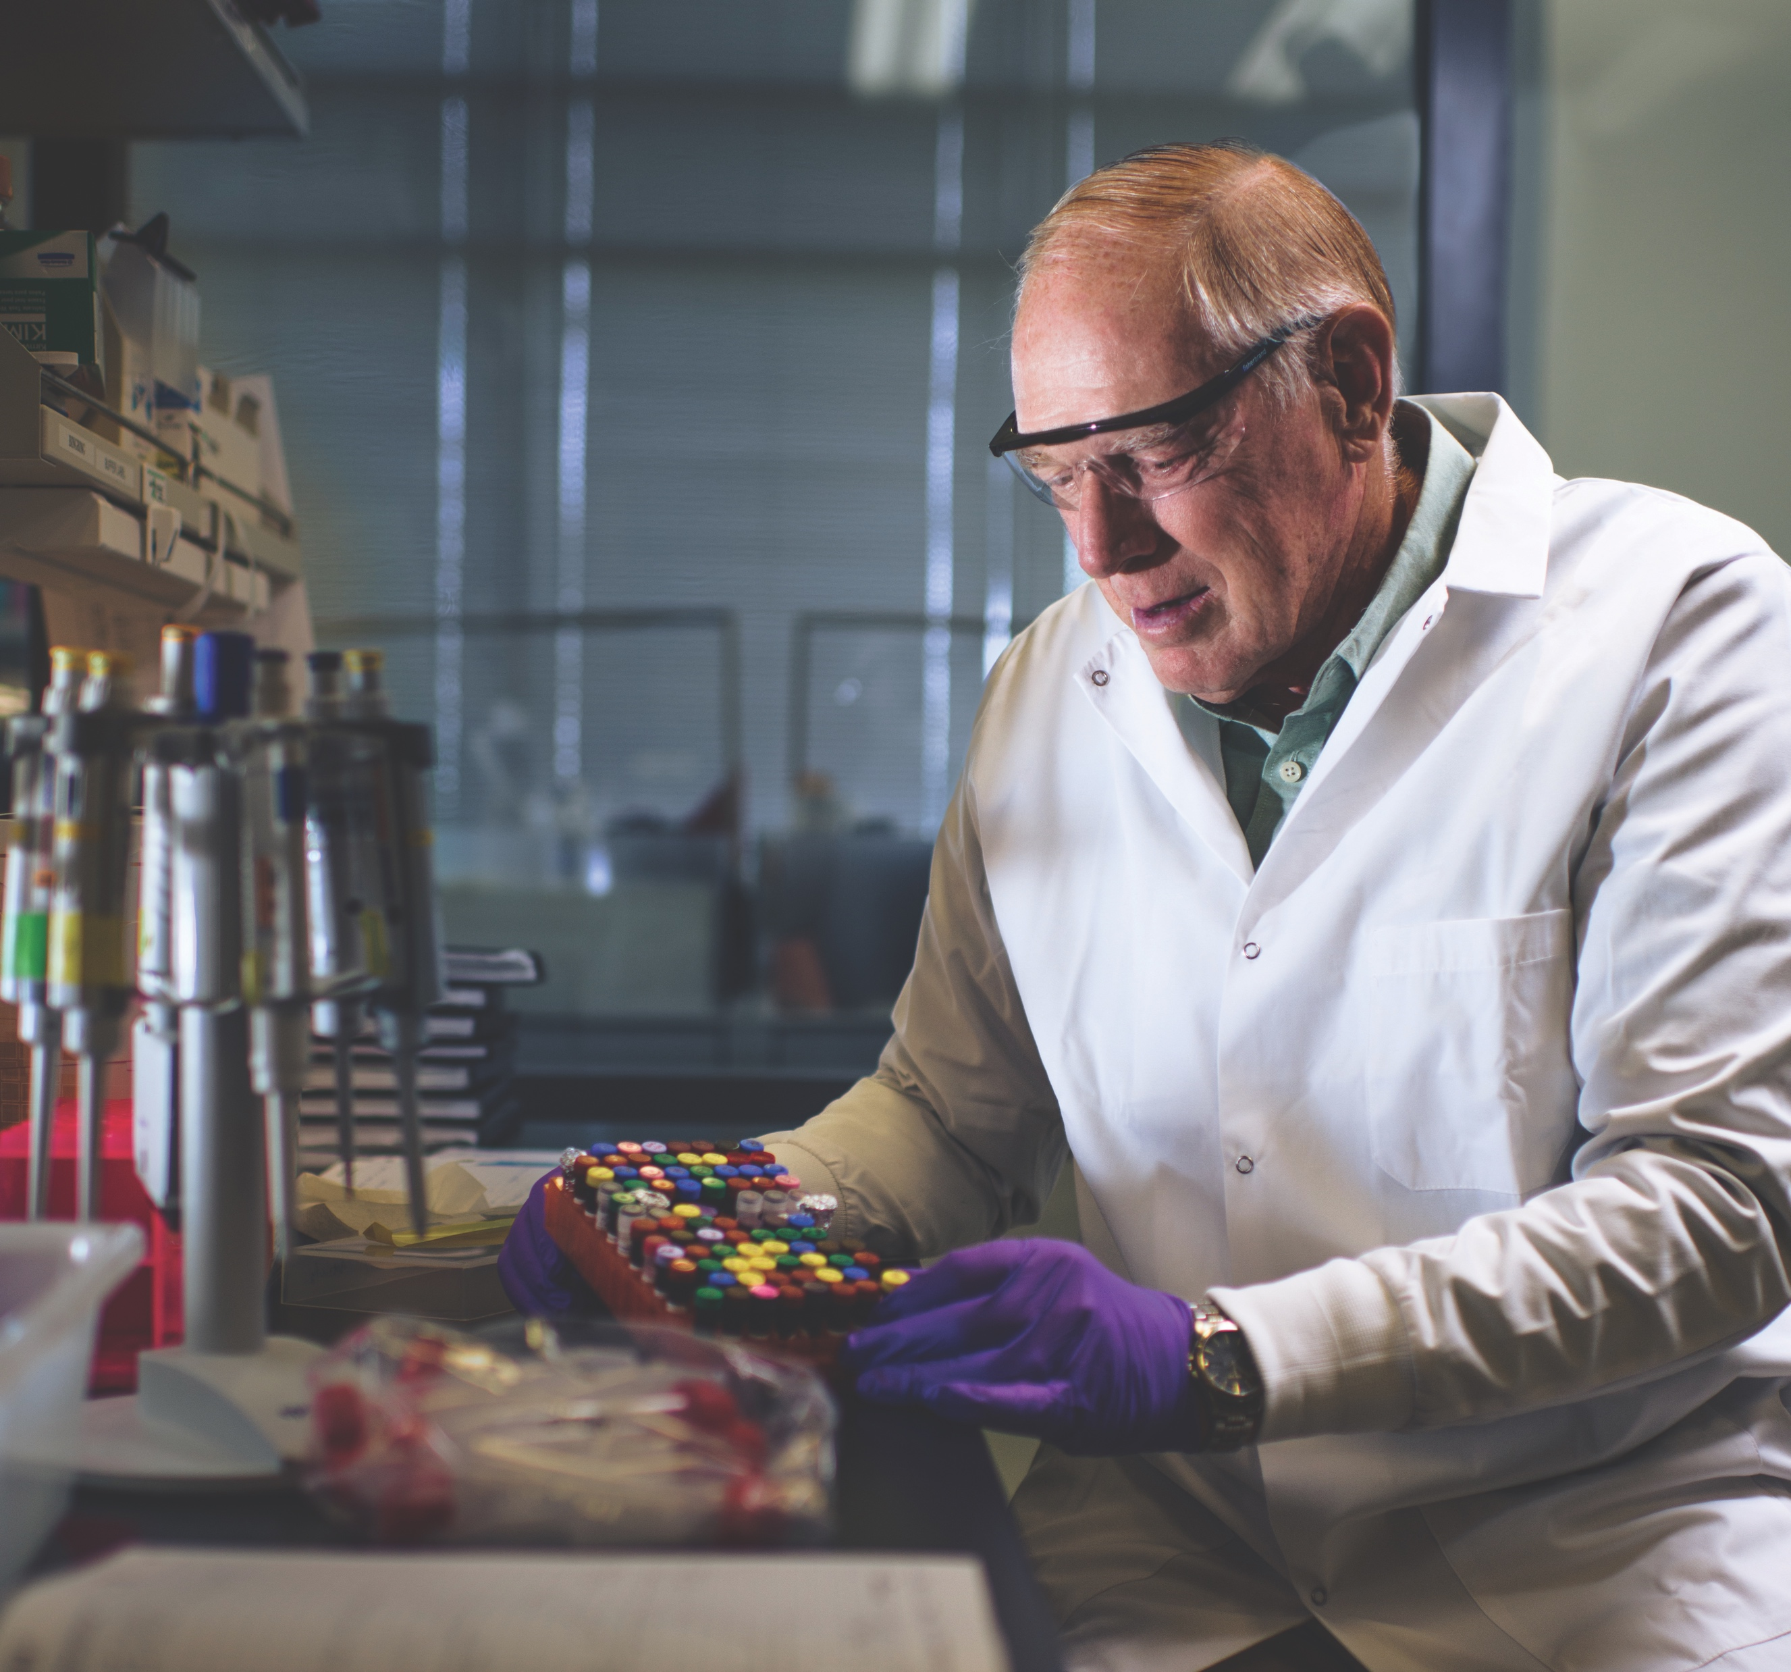
INNOVATION
Where World-Changing Ideas Come to Life
Our top-tier researchers at Purdue benefit from a myriad of resources that bridge the gap between their groundbreaking efforts in the lab and the many intricacies of business law, patents and product promotion that are required to bring a world-changing idea to market. This creates an ecosystem where startups thrive.
A few notable startups from Purdue include:
Umoja Biopharma — a Purdue-affiliated biotechnology company focused on using a patient’s own immune cells to kill cancerous cells
Greenshoot Materials — a company licensing Purdue technologies to create compostable, nontoxic cellulose-based coatings to replace plastic in food packaging
Ixana — a Purdue-affiliated company that is developing wearable smart devices that securely and efficiently communicate using touch and the naturally conductive properties of the wearer’s body
Eradivir — a Purdue-developed biotechnology company that leverages small molecule targeting technology to increase the effectiveness of immunotherapies for viral infections like influenza

Slide 17
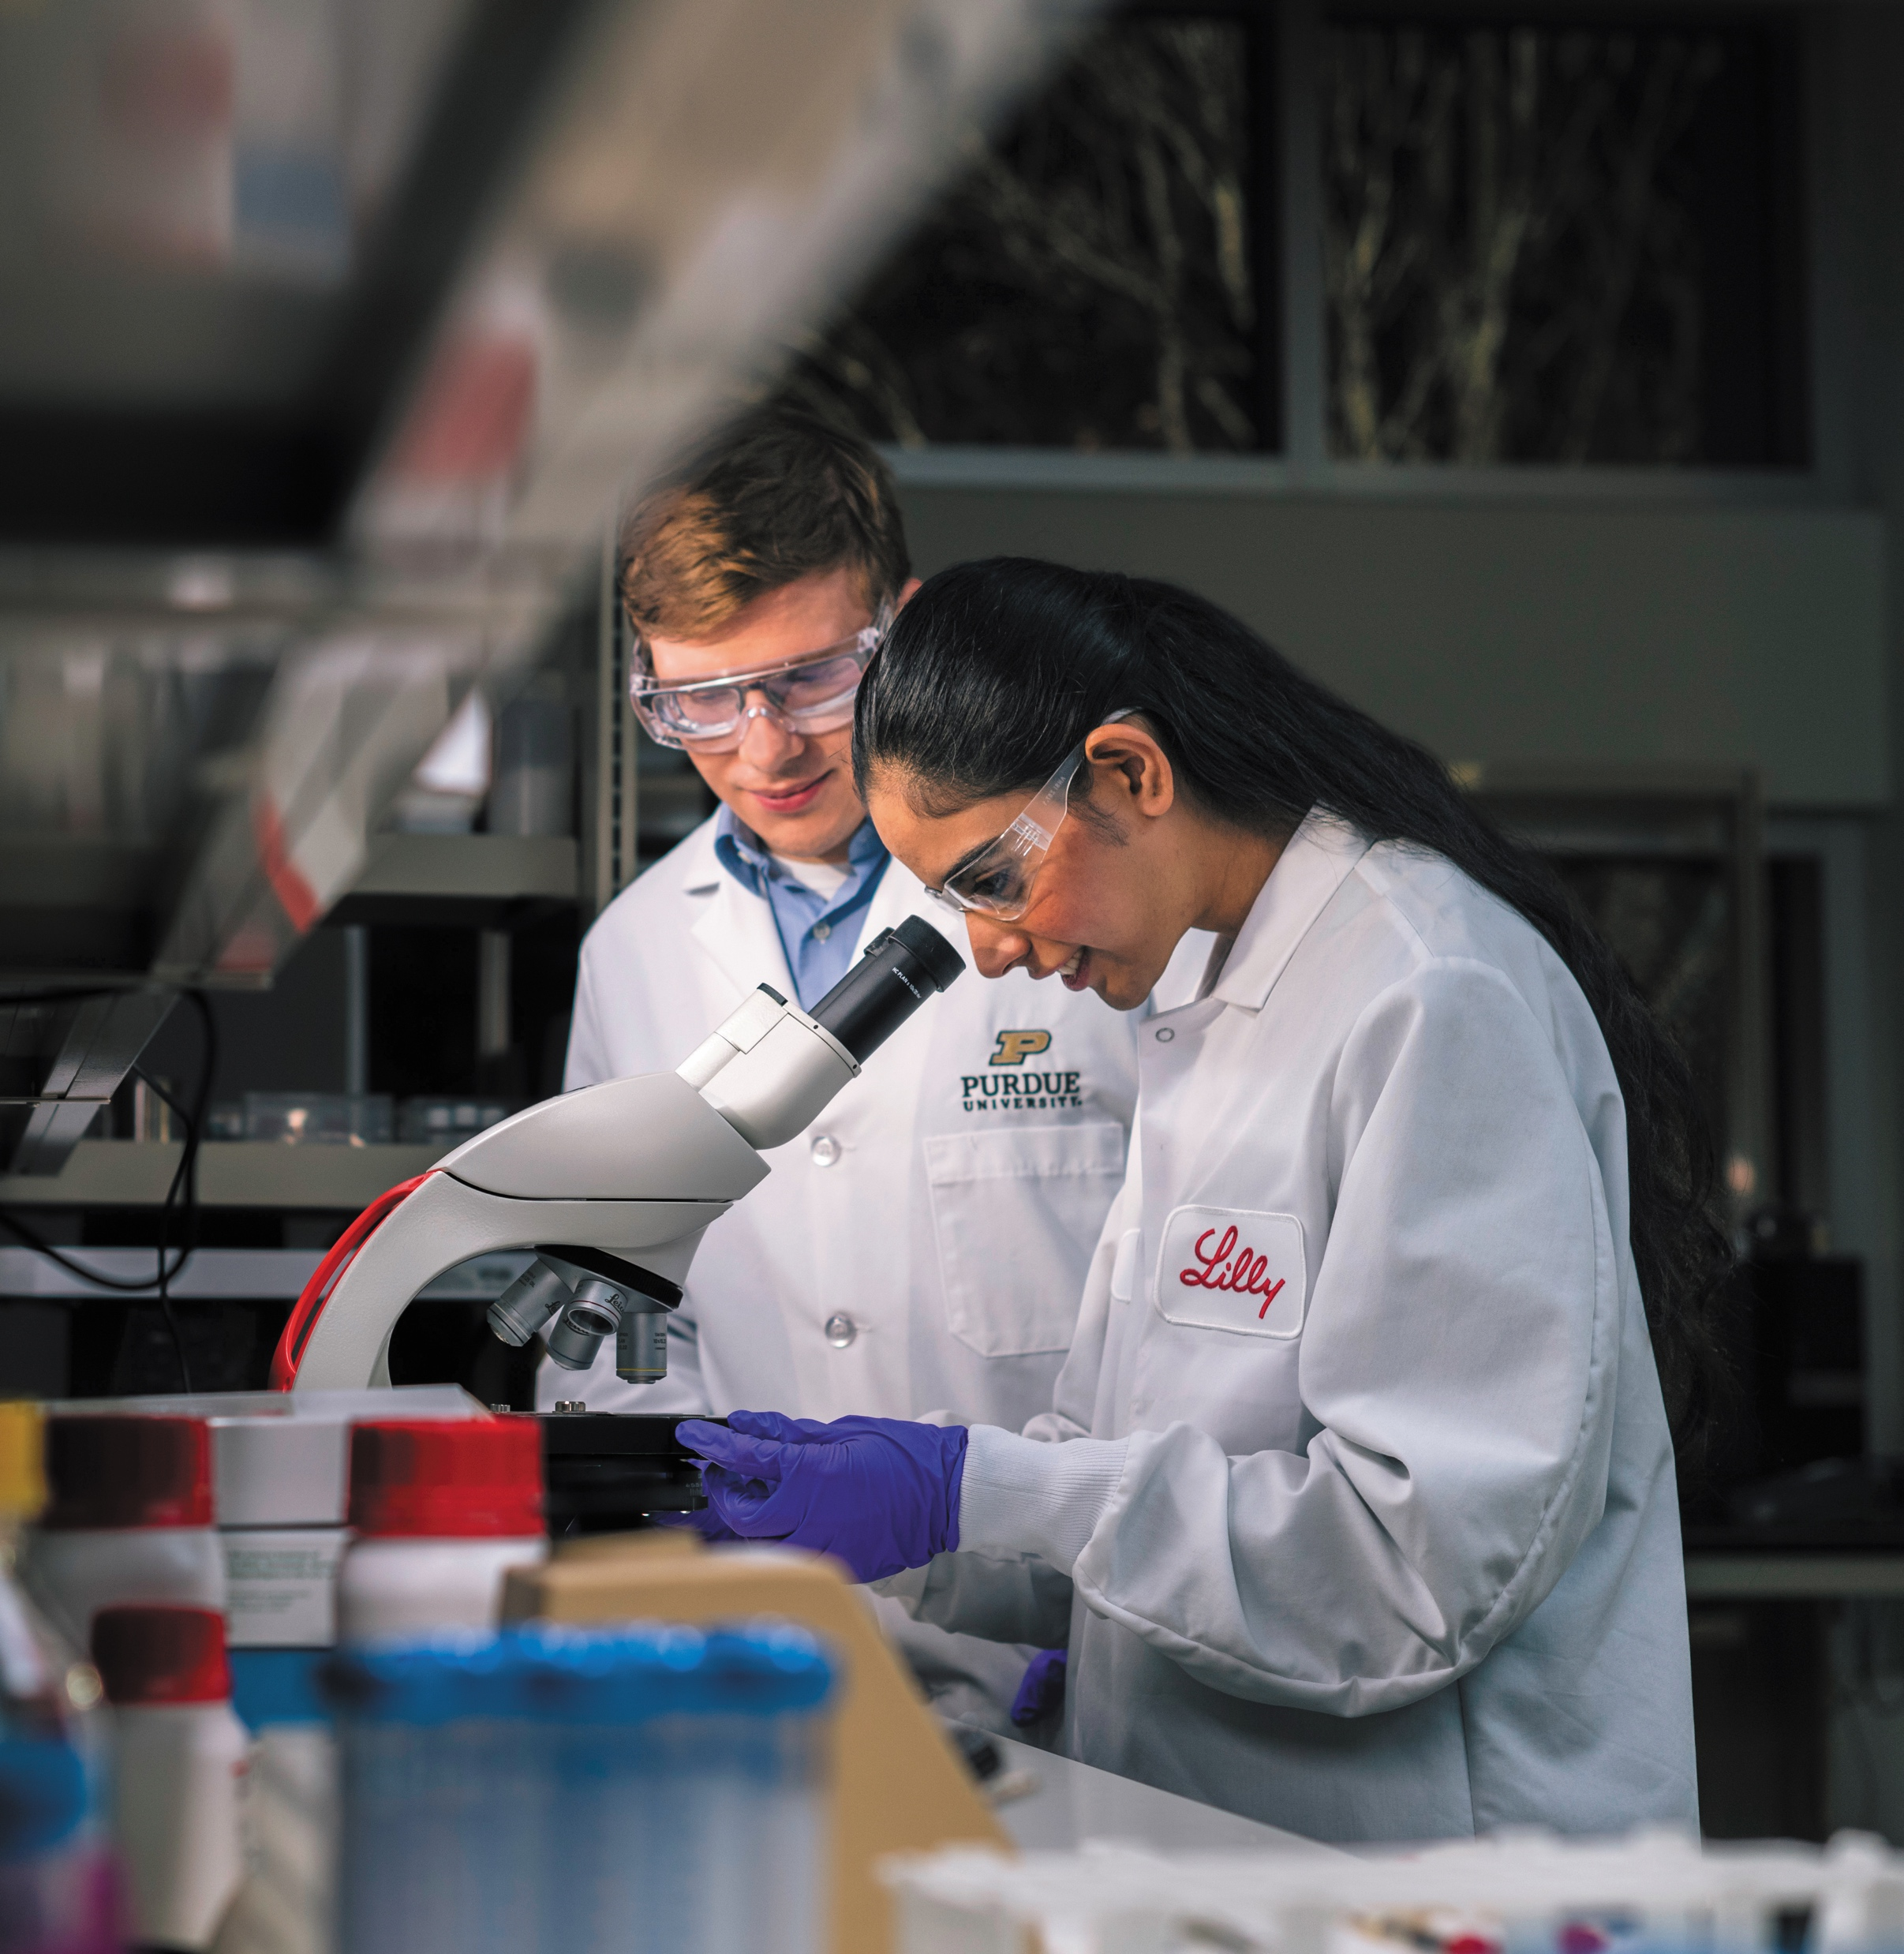


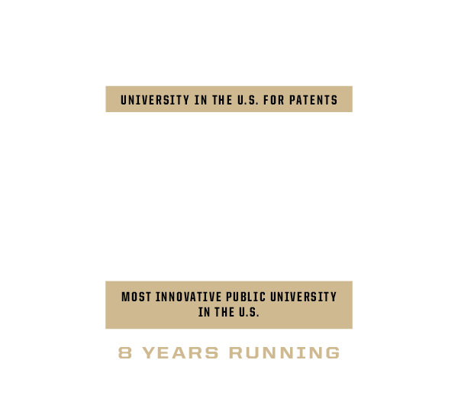
INNOVATION
We Come Together for Lifesaving Research

Slide 18
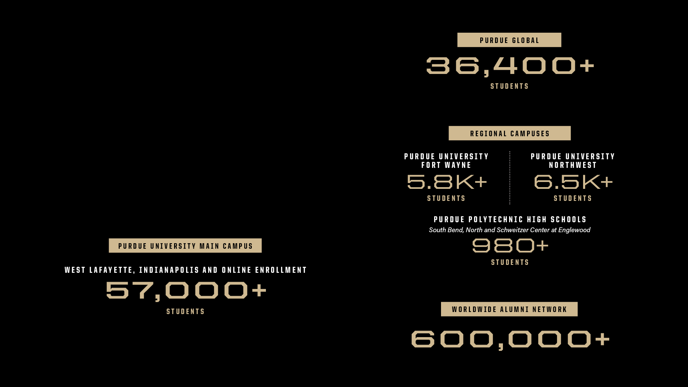
A GLOBAL NETWORK
Over 108,000 Strong
Fall 2025 Enrollment

Slide 19

COMMUNITY & CULTURE
We are proud of the community that grows here. Purdue brings together students from every background, every perspective and every walk of life to uncover new knowledge, understand who we are as individuals and create meaningful change that will transform the world.
The complete university experience
In our university residences, students learn and grow through the relationships they make, becoming a close-knit community of civic-minded global citizens. With unique educational opportunities, cultural centers, recreation and clubs, access to faculty members, and proximity to a wealth of campus resources, every Purdue student has room to focus on their goals while getting the full collegiate experience, all in one place. Our Division I athletics bring a kinetic atmosphere to campus on game day that’s impossible to re-create.
Living and learning together
Students also have the opportunity to incorporate collaborative learning into their Purdue experience through learning communities. For example, our John Martinson Honors College and Residences enables 850 honors students to live and learn together within 20,000 square feet of academic space.
Engagement beyond the classroom
Students not only have the chance to gain new experiences on our campuses but are also able to take part in critical industries across the country. Companies like Lilly, Elanco Animal Health, Beck’s Hybrids, Kiewit Corp., Caterpillar, Dallara and more have partnered with Purdue to offer internships, co-ops and involvement programs that give students the opportunity to gain on-the-job experience and one-of-a-kind networking.

Slide 20

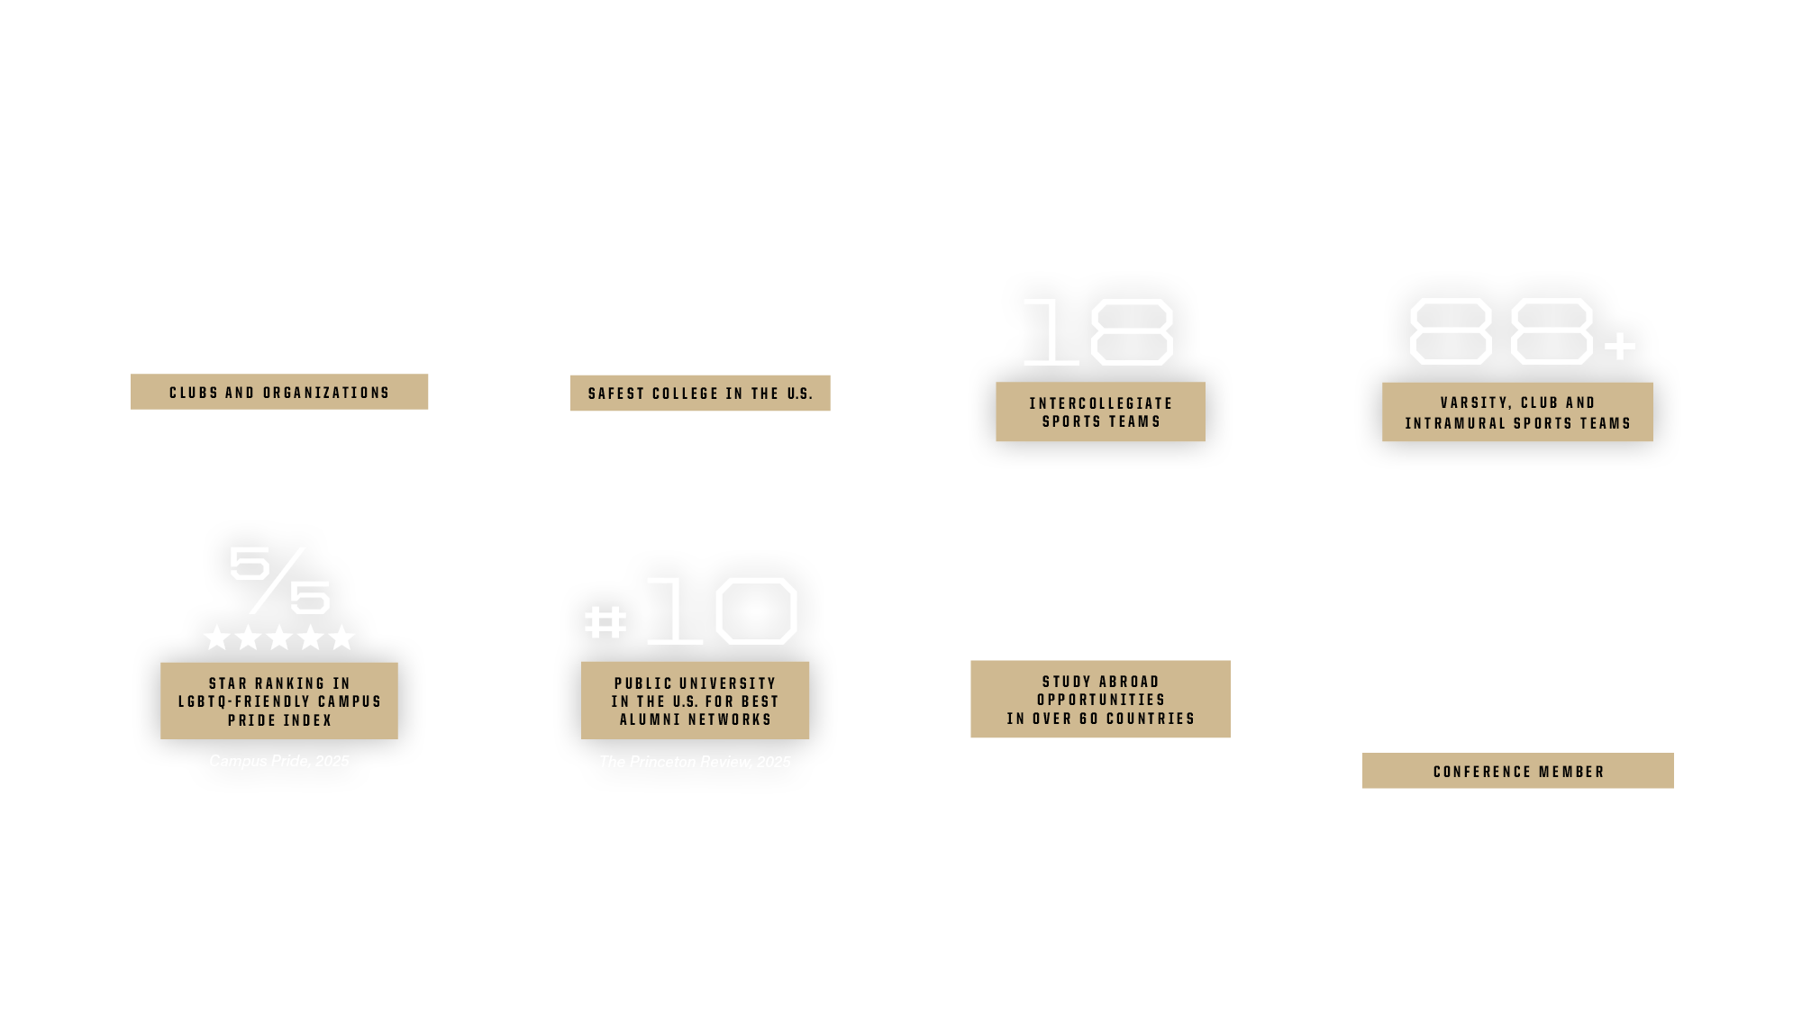
COMMUNITY & CULTURE

Slide 21






purdue.edu
stories.purdue.edu
@PurdueUniversity
@LifeAtPurdue
@PurdueGlobal
To view the information included in this presentation as a PDF or a printable document, visit the Purdue Brand Studio website.

